Slide 1




CS Bridge, Lecture 10 Animation

Slide 2


Learning Goals
Get more practice writing programs with graphics
Understand how parameters are passed between functions
Write graphics programs with animation

Slide 3
End Goal: Bouncing Ball!

Slide 4
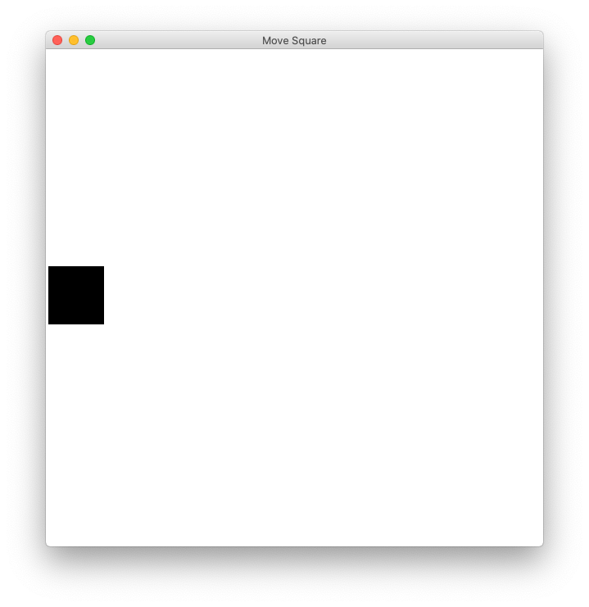
Checkpoint: “Move To Center”

Slide 5
Lecture Plan
Review: Graphics
Animation Loop Structure
Example: Move To Center
Practice: Bouncing Ball
Passing Parameters
Notes:
A whole new way of thinking

Slide 6
Lecture Plan
Review: Graphics
Animation Loop Structure
Example: Move To Center
Practice: Bouncing Ball
Passing Parameters

Slide 7
In our last episode…

Slide 8
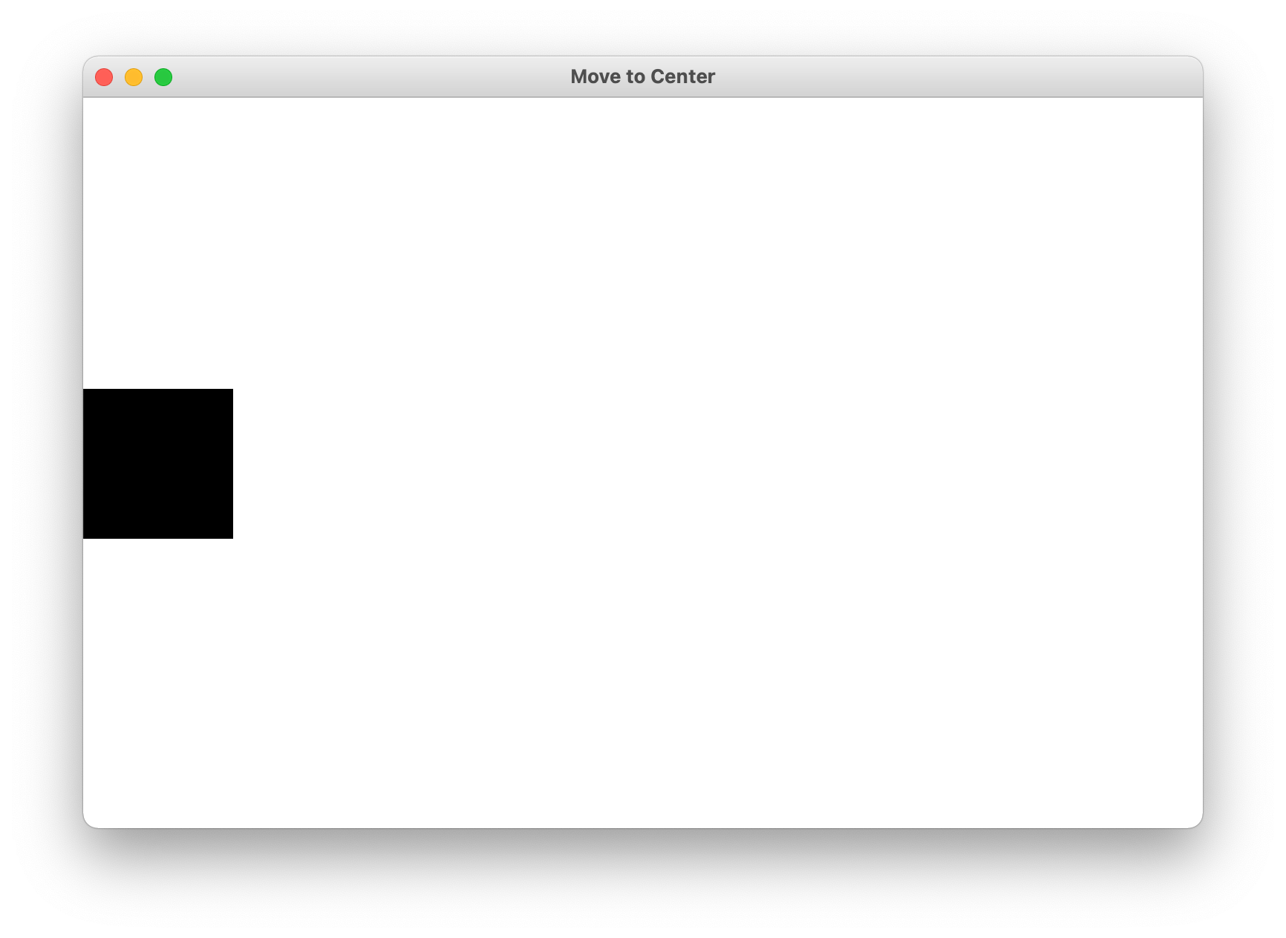
Graphics From Tkinter
from graphics import Canvas

Slide 9
Add Square

Slide 10
Add Square
SQUARE_SIZE = 100
def main():
canvas = Canvas()
canvas.set_canvas_title("Move to Center")
square_top_y = canvas.get_canvas_height() / 2 - SQUARE_SIZE / 2
rect = canvas.create_rectangle(0, square_top_y, SQUARE_SIZE, square_top_y + SQUARE_SIZE)
canvas.set_color(rect, "black")
canvas.mainloop()

Slide 11
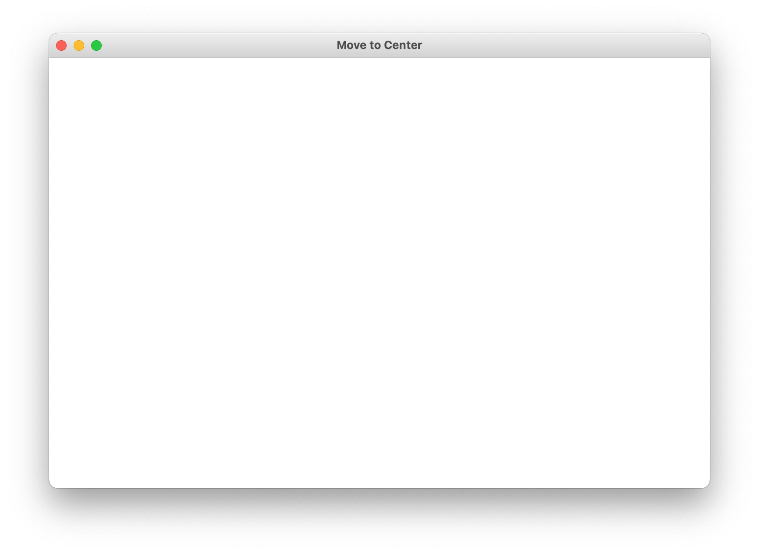
Add Square
canvas = Canvas()
canvas.set_canvas_title("Move to Center")
square_top_y = canvas.get_canvas_height() / 2 - SQUARE_SIZE / 2
rect = canvas.create_rectangle(0, square_top_y, SQUARE_SIZE, square_top_y + SQUARE_SIZE)
canvas.set_color(rect, "black")
canvas.mainloop()

Slide 12
Add Square
canvas = Canvas()
canvas.set_canvas_title("Move to Center")
square_top_y = canvas.get_canvas_height() / 2 - SQUARE_SIZE / 2
rect = canvas.create_rectangle(0, square_top_y, SQUARE_SIZE, square_top_y + SQUARE_SIZE)
canvas.set_color(rect, "black")
canvas.mainloop()
canvas.get_canvas_height() / 2

Slide 13
Add Square
canvas = Canvas()
canvas.set_canvas_title("Move to Center")
square_top_y = canvas.get_canvas_height() / 2 - SQUARE_SIZE / 2
rect = canvas.create_rectangle(0, square_top_y, SQUARE_SIZE, square_top_y + SQUARE_SIZE)
canvas.set_color(rect, "black")
canvas.mainloop()
canvas.get_canvas_height() / 2 – SQUARE_SIZE / 2
canvas.get_canvas_height() / 2

Slide 14

Add Square
canvas = Canvas()
canvas.set_canvas_title("Move to Center")
square_top_y = canvas.get_canvas_height() / 2 - SQUARE_SIZE / 2
rect = canvas.create_rectangle(0, square_top_y, SQUARE_SIZE, square_top_y + SQUARE_SIZE)
canvas.set_color(rect, "black")
canvas.mainloop()
square_top_y
Some “heavy duty” variables allow you to call functions on them
square_top_y + SQUARE_SIZE

Slide 15
Add Square
canvas = Canvas()
canvas.set_canvas_title("Move to Center")
square_top_y = canvas.get_canvas_height() / 2 - SQUARE_SIZE / 2
rect = canvas.create_rectangle(0, square_top_y, SQUARE_SIZE, square_top_y + SQUARE_SIZE)
canvas.set_color(rect, "black")
canvas.mainloop()
(0, square_top_y)
(SQUARE_SIZE, square_top_y + SQUARE_SIZE)

Slide 16
Add Square
canvas = Canvas()
canvas.set_canvas_title("Move to Center")
square_top_y = canvas.get_canvas_height() / 2 - SQUARE_SIZE / 2
rect = canvas.create_rectangle(0, square_top_y, SQUARE_SIZE, square_top_y + SQUARE_SIZE)
canvas.set_color(rect, "black")
canvas.mainloop()

Slide 17
Add Square
canvas = Canvas()
canvas.set_canvas_title("Move to Center")
square_top_y = canvas.get_canvas_height() / 2 - SQUARE_SIZE / 2
rect = canvas.create_rectangle(0, square_top_y, SQUARE_SIZE, square_top_y + SQUARE_SIZE)
canvas.set_color(rect, "black")
canvas.mainloop()

Slide 18
End of review!

Slide 19
Lecture Plan
Review: Graphics
Animation Loop Structure
Example: Move To Center
Practice: Bouncing Ball
Passing Parameters

Slide 20
How do movies or games animate?

Slide 21
Checkpoint: “Move To Center”

Slide 22
Animation Loop
def main():
# setup done once
while ???:
# update world
# pause
time.sleep(DELAY)
canvas.mainloop()

Slide 23
Animation Loop
def main():
# setup done once
while ???:
# update world
# pause
time.sleep(DELAY)
canvas.mainloop()
Make all the variables you need.

Slide 24
Animation Loop
def main():
# setup done once
while ???:
# update world
# pause
time.sleep(DELAY)
canvas.mainloop()
The animation loop is a repetition of heartbeats, either forever (while True) or until some condition is no longer true.

Slide 25
Animation Loop
def main():
# setup done once
while ???:
# update world
# pause
time.sleep(DELAY)
canvas.mainloop()
Each heart-beat, update the world forward one frame

Slide 26
Animation Loop
def main():
# setup done once
while ???:
# update world
# pause
time.sleep(DELAY)
canvas.mainloop()
If you don’t pause, humans won’t be able to see it!

Slide 27
Animation Loop
def main():
# setup done once
while ???:
# update world
# pause
time.sleep(DELAY)
canvas.mainloop()
Make sure to call mainloop() to make your program run correctly.

Slide 28
Lecture Plan
Review: Graphics
Animation Loop Structure
Example: Move To Center
Practice: Bouncing Ball
Passing Parameters

Slide 29
Checkpoint: “Move To Center”

Slide 30
Animation Loop
def main():
# setup done once
while ???:
# update world
# pause
time.sleep(DELAY)
canvas.mainloop()

Slide 31
Animation Loop
def main():
# setup done once
canvas = Canvas()
canvas.set_canvas_title("Move to Center")
square_top_y = canvas.get_canvas_height() / 2 - SQUARE_SIZE / 2
rect = canvas.create_rectangle(0, square_top_y, SQUARE_SIZE, square_top_y + SQUARE_SIZE)
canvas.set_color(rect, "black")
while ???:
# update world
# pause
time.sleep(DELAY)
canvas.mainloop()

Slide 32
Animation Loop
def main():
# setup done once
canvas = Canvas()
canvas.set_canvas_title("Move to Center")
square_top_y = canvas.get_canvas_height() / 2 - SQUARE_SIZE / 2
rect = canvas.create_rectangle(0, square_top_y, SQUARE_SIZE, square_top_y + SQUARE_SIZE)
canvas.set_color(rect, "black")
while ???:
# update world
canvas.move(rect, 1, 0)
canvas.update()
# pause
time.sleep(DELAY)
canvas.mainloop()

Slide 33
Animation Loop
def main():
# setup done once
canvas = Canvas()
canvas.set_canvas_title("Move to Center")
square_top_y = canvas.get_canvas_height() / 2 - SQUARE_SIZE / 2
rect = canvas.create_rectangle(0, square_top_y, SQUARE_SIZE, square_top_y + SQUARE_SIZE)
canvas.set_color(rect, "black")
while ???:
# update world
canvas.move(rect, 1, 0)
canvas.update()
# pause
time.sleep(DELAY)
canvas.mainloop()
Move the rectangle 1 pixel to the right.

Slide 34
Animation Loop
def main():
# setup done once
canvas = Canvas()
canvas.set_canvas_title("Move to Center")
square_top_y = canvas.get_canvas_height() / 2 - SQUARE_SIZE / 2
rect = canvas.create_rectangle(0, square_top_y, SQUARE_SIZE, square_top_y + SQUARE_SIZE)
canvas.set_color(rect, "black")
while ???:
# update world
canvas.move(rect, 1, 0)
canvas.update()
# pause
time.sleep(DELAY)
canvas.mainloop()
Tells the canvas to update the screen. Don’t forget this! Call it once you are finished making all canvas changes for now.

Slide 35
Animation Loop
def main():
# setup done once
canvas = Canvas()
canvas.set_canvas_title("Move to Center")
square_top_y = canvas.get_canvas_height() / 2 - SQUARE_SIZE / 2
rect = canvas.create_rectangle(0, square_top_y, SQUARE_SIZE, square_top_y + SQUARE_SIZE)
canvas.set_color(rect, "black")
while ???:
# update world
canvas.move(rect, 1, 0)
canvas.update()
# pause
time.sleep(DELAY)
canvas.mainloop()
When do we want to stop the animation loop?

Slide 36
Let’s live code!

Slide 37
Move to Center
def main():
# setup done once
canvas = Canvas()
canvas.set_canvas_title("Move to Center")
square_top_y = canvas.get_canvas_height() / 2 - SQUARE_SIZE / 2
rect = canvas.create_rectangle(0, square_top_y, SQUARE_SIZE, square_top_y + SQUARE_SIZE)
canvas.set_color(rect, "black")
while is_not_past_center(canvas, rect):
# update world
canvas.move(rect, 1, 0)
canvas.update()
# pause
time.sleep(DELAY)
canvas.mainloop()

Slide 38
More Helpful Graphics Functions
canvas.move(obj, dx, dy) | Moves obj using the displacements dx and dy.
canvas.moveto(obj, x, y) | Sets the location of obj to the specified coordinates.
# move shape to some new coordinates
canvas.moveto(shape, new_x, new_y)
# move shape by a given change_x and change_y
canvas.move(shape, change_x, change_y)

Slide 39
We are ready...

Slide 40
Lecture Plan
Review: Graphics
Animation Loop Structure
Example: Move To Center
Practice: Bouncing Ball
Passing Parameters

Slide 41
Bouncing Ball

Slide 42
Bouncing Ball: Milestone 1 - Movement

Slide 43
Let’s try it!

Slide 44
Bouncing Ball
First heartbeat
Key variable: how much the ball position
change each heartbeat?

Slide 45
Bouncing Ball
First heartbeat
change_x
change_y
The move function takes in
a change in x and a change in y

Slide 46
Bouncing Ball
Second heartbeat
change_x
change_y

Slide 47
Bouncing Ball
Third heartbeat
change_x
change_y

Slide 48
Bouncing Ball
What happens when we hit a wall?

Slide 49
Bouncing Ball
We have this velocity
change_x
change_y

Slide 50
Bouncing Ball
Our new velocity
change_y
change_x
When reflecting vertically: change_y = -change_y

Slide 51
Bouncing Ball
Seventh heartbeat
change_y
change_x

Slide 52
Bouncing Ball
Eighth heartbeat
change_y
change_x

Slide 53
Bouncing Ball
Ninth heartbeat
change_y
change_x

Slide 54
Bouncing Ball
We want this!

Slide 55
Bouncing Ball
This was our old velocity
change_y
change_x

Slide 56
Bouncing Ball
This is our new velocity
change_y
change_x
When reflecting horizontally: change_x = -change_x

Slide 57
Bouncing Ball
Tenth heartbeat
change_y
change_x
When reflecting horizontally: change_x = -change_x

Slide 58
Bouncing Ball

Slide 59
Lecture Plan
Review: Graphics
Animation Loop Structure
Example: Move To Center
Practice: Bouncing Ball
Passing Parameters

Slide 60
Coming soon…

Slide 61
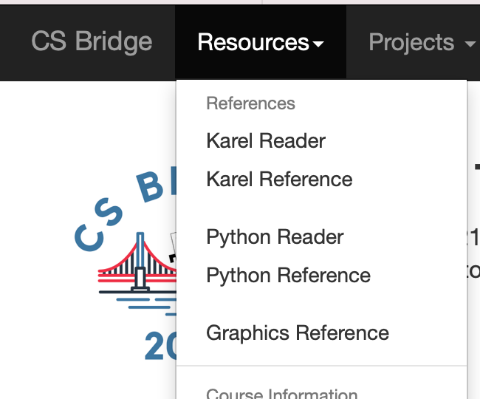
Graphics Resources

Slide 62

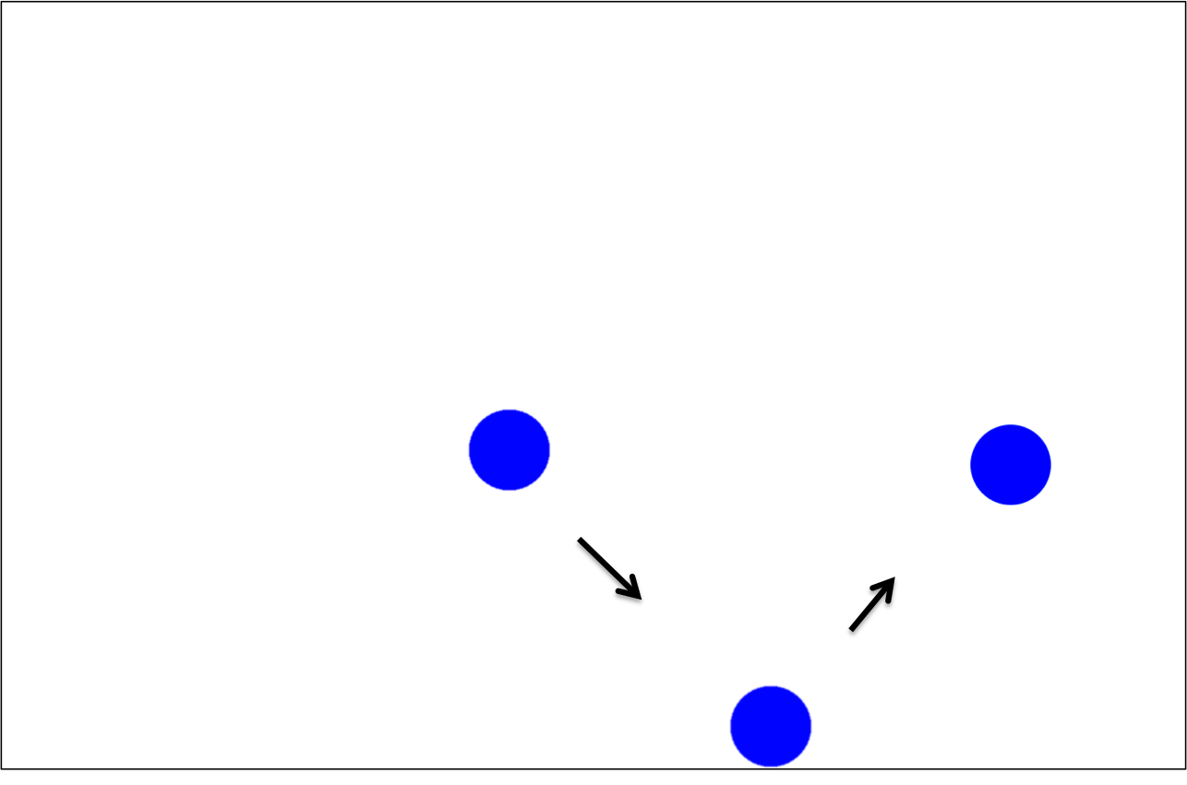
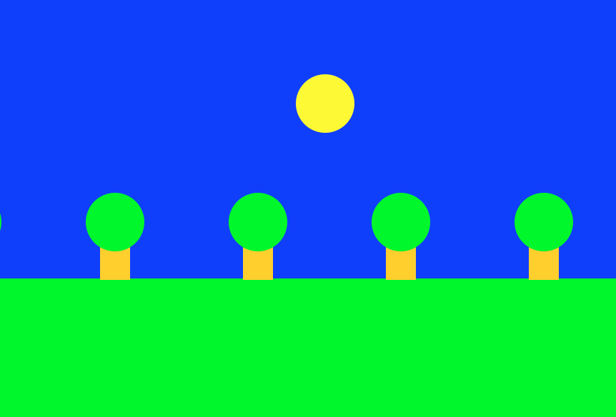
Rest Of Today
Quickstart: Program a mystery square… (???)
Section: Complete the implementation of the bouncing ball program
Project: Use animation to create your own short film!

Slide 63
What’s Next?
Time for your section’s quickstart time!
Check your section’s Ed group for more information

Slide 64
Extra Slides

Slide 65
Wait a minute….
def make_ball(canvas):
Does this copy the canvas??!!
Variables are stored using a reference. Which is like a URL. The URL gets copied when you pass the variable

Slide 66
Lecture Plan
Review: Graphics
Animation Loop Structure
Example: Move To Center
Practice: Bouncing Ball
Passing Parameters

Slide 67
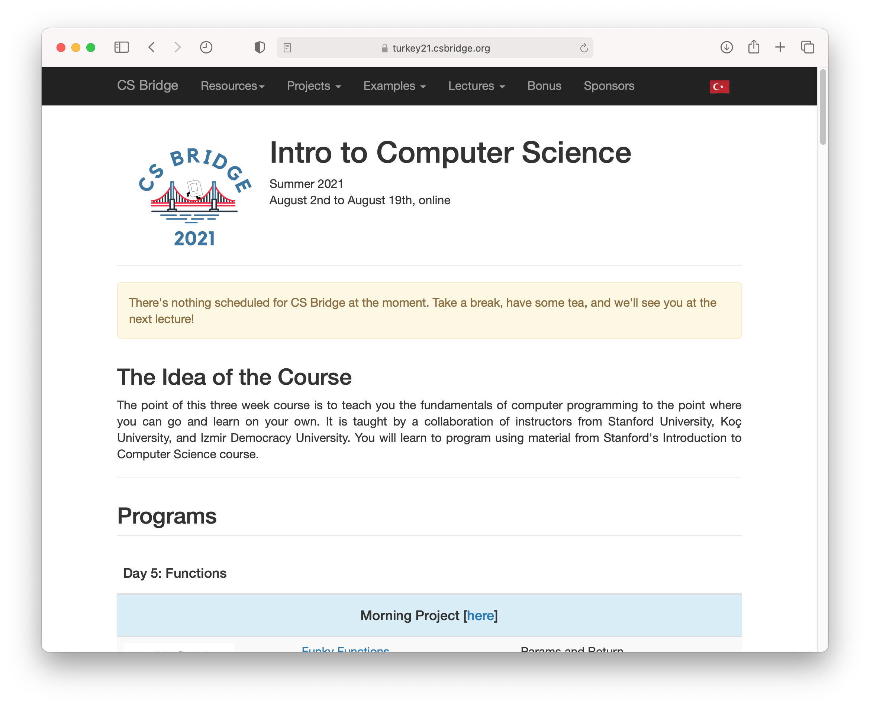
How do we share websites?
turkey21.csbridge.org

Slide 68
Passing Parameters
def main():
canvas = Canvas()
make_ball(canvas)
def make_ball(canvas):
canvas.create_oval( … )
stack
heap
main

Slide 69
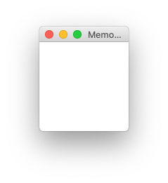
Passing Parameters
def main():
canvas = Canvas()
make_ball(canvas)
def make_ball(canvas):
canvas.create_oval( … )
stack
heap
memory.com/42
main
memory.com/42
canvas

Slide 70
Passing Parameters
def main():
canvas = Canvas()
make_ball(canvas)
def make_ball(canvas):
canvas.create_oval( … )
stack
heap
memory.com/42
main
canvas
42

Slide 71
Passing Parameters
def main():
canvas = Canvas()
make_ball(canvas)
def make_ball(canvas):
canvas.create_oval( … )
stack
heap
memory.com/42
main
canvas
42
make_ball
canvas

Slide 72
Passing Parameters
def main():
canvas = Canvas()
make_ball(canvas)
def make_ball(canvas):
canvas.create_oval( … )
stack
heap
memory.com/42
main
canvas
42
make_ball
canvas
42

Slide 73
Passing Parameters
def main():
canvas = Canvas()
make_ball(canvas)
def make_ball(canvas):
canvas.create_oval( … )
stack
heap
memory.com/42
main
canvas
42
make_ball
canvas
42

Slide 74
Passing Parameters
def main():
canvas = Canvas()
make_ball(canvas)
def make_ball(canvas):
canvas.create_oval( … )
stack
heap
memory.com/42
main
canvas
42
make_ball
canvas
42

Slide 75
Passing Parameters
def main():
canvas = Canvas()
make_ball(canvas)
def make_ball(canvas):
canvas.create_oval( … )
stack
heap
memory.com/42
main
canvas
42

Slide 76
Key Idea: Passing Parameters
When passing variables, some act just like you are passing a URL.
That allows functions to modify the variable

